Slide 1
SafePlate – Instant Allergen Check for Packaged Food
Allergen detection to make food shopping safer

Slide 2
Problem Statement
Heading: The Food Allergy Challenge
Points:
32 million Americans have food allergies.
Reading ingredient labels can be confusing or time-consuming.
Risk of accidental allergen exposure can be life-threatening.

Slide 3
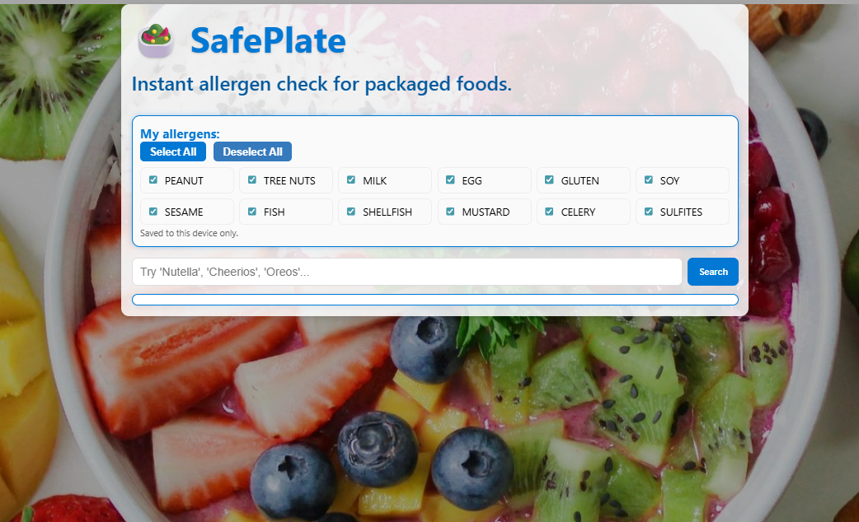
Our Solution
Heading: SafePlate
Points:
Instant allergen detection by searching product information.
Personalized allergen profiles.
Simple, user-friendly interface.

Slide 4
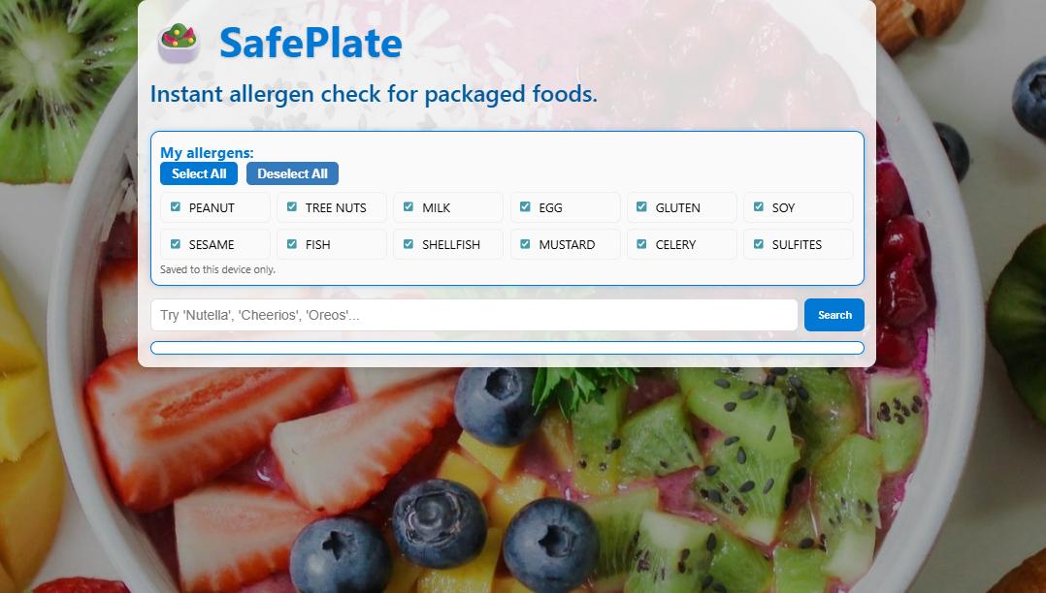
Key Features
Points:
Allergen Profile: Save and manage personal allergens.
Smart Search: Quickly check allergens in packaged foods.
Multi-Allergen Detection: Supports 12 common allergens.

Slide 5
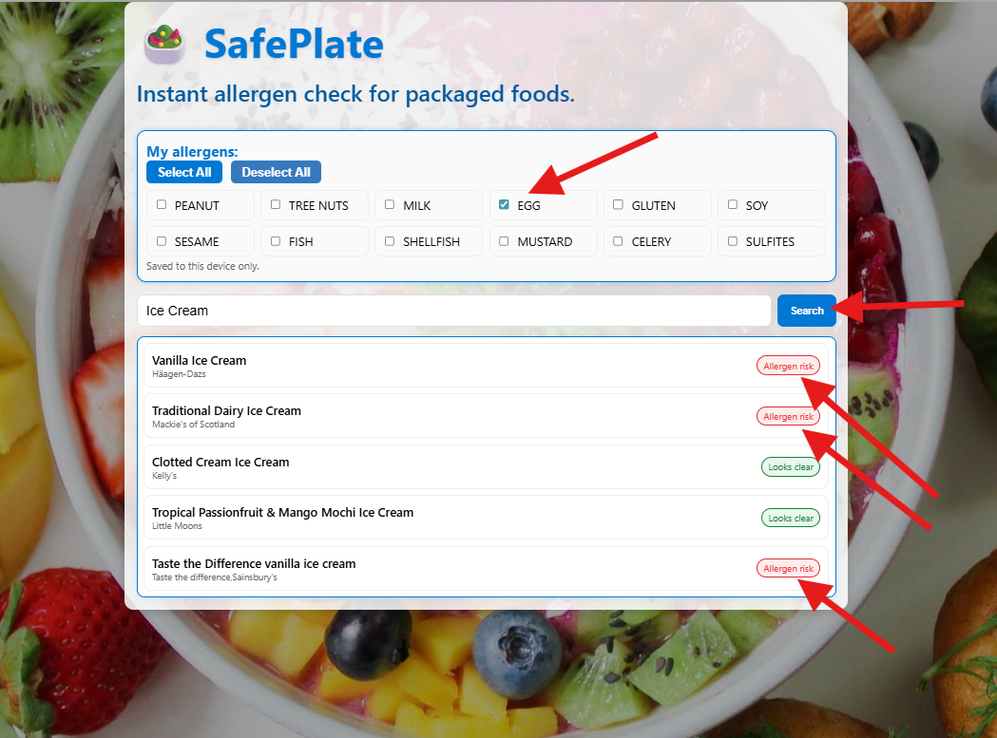
How It Works
Steps:
User selects allergens from the checklist.
Searches for a food product.
SafePlate scans OpenFoodFacts database.
Allergens are highlighted instantly.

Slide 6
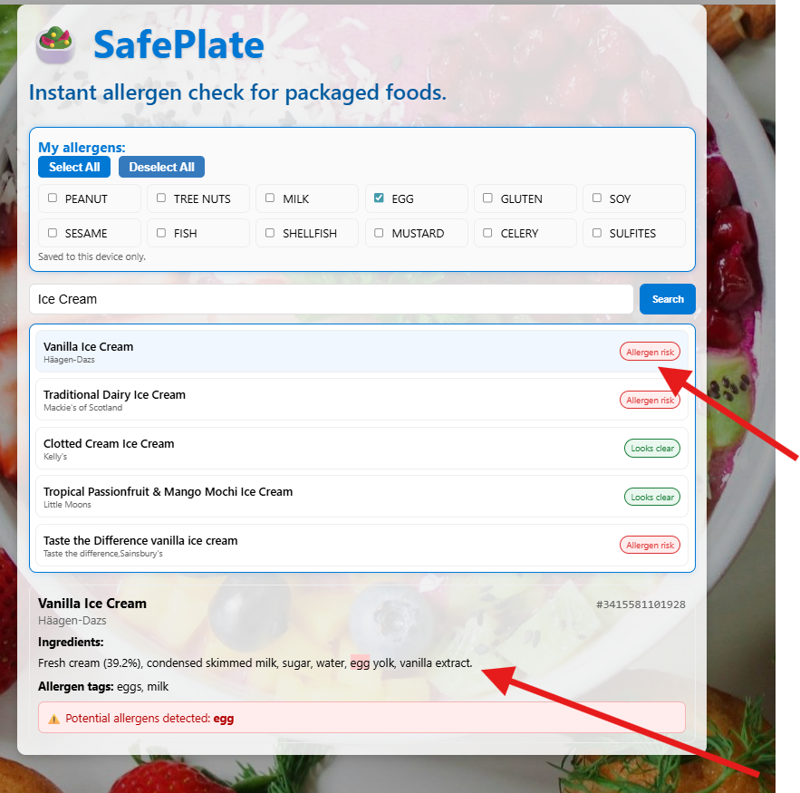
The ingredients showing selected product with potential allergy detected

Slide 7

Technology Stack
Points:
Frontend: React + TypeScript
Backend/API: OpenFoodFacts API
Styling: Custom CSS + Microsoft Fluent design elements.

Slide 8
Future Enhancements
Points:
Barcode scanning for faster results.
Multilingual allergen detection.
Offline mode.
AI-powered allergen risk prediction.
OpenAI Chatbot Integration for Food Allergies
Visual: Icons for mobile, AI, and barcode.

